Slide 1
What I will do…
Prime Minister Yosuke Higuchi

Slide 2

Introducing Programming classes
Critical thinking
Logical thinking
Important skill for today’s society

Slide 3

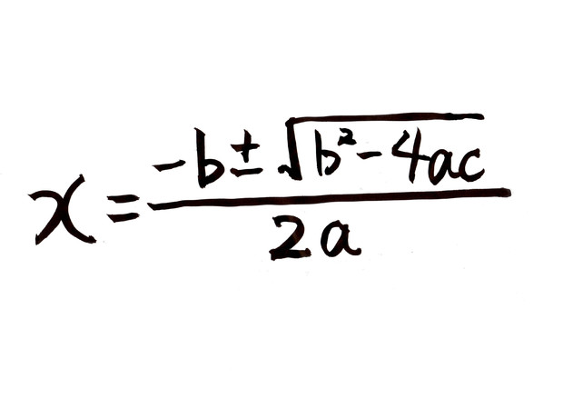
Critical Thinking
Coding programs
Think by yourself
Students nowadays
Do not think but memorize
Entrance exams

Slide 4
Critical Thinking
Programming classes
Develop students’ critical thinking
Also, develop their creativity

Slide 5

Logical Thinking
Computers can’t think
Humans have to command
Require logical thinking to write programs
Writing programs
Decompose a solution
Translate in a programming language
Finding errors
Cause and effect

Slide 6
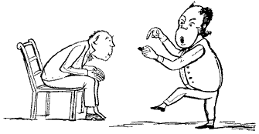
Logical Thinking
Everyone should learn how to code
Important to have logical thinking skills

Slide 7

Important Skill

Slide 8
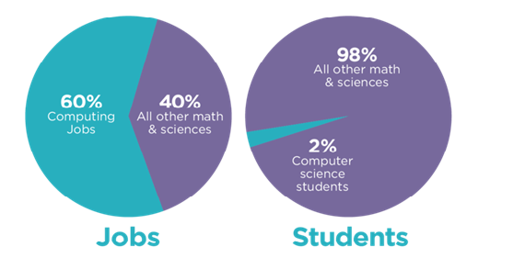
Important Skill

Slide 9
Important Skill
Big demand for programmers
Not many people know how to program
Provide opportunities for students to learn how to code
Students can find themselves like programming

Slide 10
Conclusion
Critical thinking skills
Make students think by themselves
Logical thinking skills
Important skill in the future
Jobs for programmers
- A number of jobs demanding computing skills

Slide 11
Reference List
http://dailygenius.com/learn-to-code/
https://www.whitehouse.gov/blog/2013/12/09/don-t-just-play-your-phone-program-it

